Slide 1
Case Study : Forecasting Airport Passenger Arrival
Deep Parikh
Dipen Talsania Michael Bayer Aghna Manzoor Sharath Kumar

Slide 2
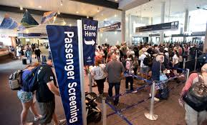
Summary: Airport problem
Long waiting lines and waiting time at security gate.
Excessive delays due to less number of checkpoint for security procedures at airport.
2
Click Insert > Header & Footer to add Area/Division/Department name.

Slide 3

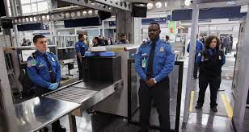
Summary
Develop a forecast for daily passenger arrivals at the BEI (Berry International Airport) for each time period for one day in July of year 4.
Determine adequate number of staff and checkpoints required to meet the service goal.

Slide 4
Objective And Question
Objective:
The objective is to determine the number of security checkpoints needed at the Airport during each 2-hour time segment in order to keep average time in the system less than 5 minutes.
Question:
How can we optimize the number of security checkpoints during each time segment to minimize waiting lines and waiting times, ensuring that passengers can move quickly through the security checkpoints without excessive delays ?

Slide 5
Available Information
Forecasting Passenger Arrivals
Passenger arrivals Data:
Number of Years: 3
Month: July
Days: 10 (given randomly each year)
Time: Every 2-hour from 4 am to 10 PM
Determining Adequate Checkpoints
Airport plans on number of staff and security checkpoint for July:
4 am to 6 PM: 6
6 PM to 8 PM: 3
8 PM to 10 PM: 2
Service time per passenger is 11.6 sec.
5
Click Insert > Header & Footer to add Area/Division/Department name.

Slide 6
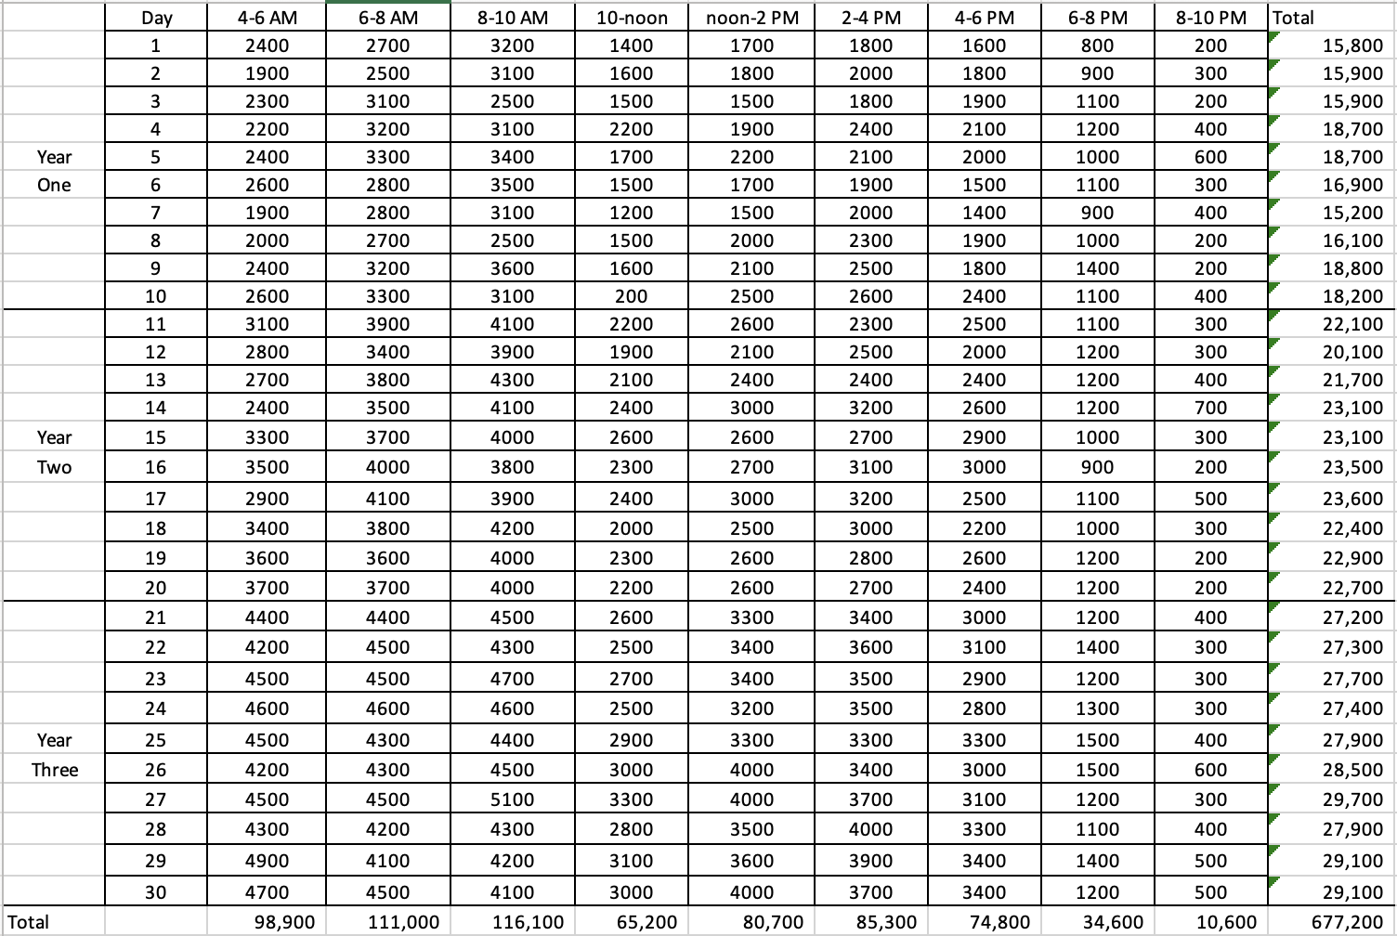
July Forecast
6
Click Insert > Header & Footer to add Area/Division/Department name.

Slide 7
Model Description
We have used Linear regression model to develop forecast.
Regression is a forecasting technique that measures the relationship of one variable the dependent variable (the outcome we want to predict) to one or more other variables the independent variable (the variable we use to make predictions).
Also to reduce the waiting time we have used Multiple-server model.
In this queuing theory, there are multiple servers or service channels available to serve customers or process tasks.
The number of servers in a multi-server model can vary, and it plays a crucial role in determining the efficiency and performance of the system.

Slide 8
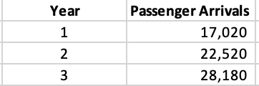
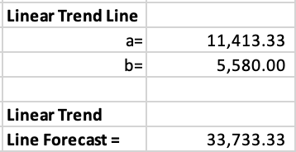
July Forecast
Linear Regression Used to determine forecast for July of year 4
=INTERCEPT(Arrival Data,Number of year)
=SLOPE(Arrival Data,Number of year)
=a+b*4
8
Click Insert > Header & Footer to add Area/Division/Department name.

Slide 9
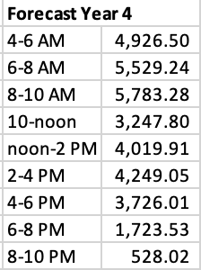
July Forecast
=(Sum of Total Passenger Arrived in from 4 -6 in last 3 year (98,900)/Sum of Total Passenger Arrived in 3 years(677,200))*Line Forecast (33,733.33)
9
Click Insert > Header & Footer to add Area/Division/Department name.

Slide 10
Number of staff and security Checkpoint
λ (Arrival rate): Number of passengers arrived every two hour
µ (Service rate): Number of passengers served every two hour
Forecast Year 4
Time slot | No. of Passengers
4-6 AM | 4927
6-8 AM | 5529
8-10 AM | 5783
10-noon | 3248
Noon-2 PM | 4020
2-4 PM | 4249
4-6 PM | 3726
6-8 PM | 1724
8-10 PM | 528
Find the minimum c (number of checkpoints) for each time slot to avoid delays.

Slide 11
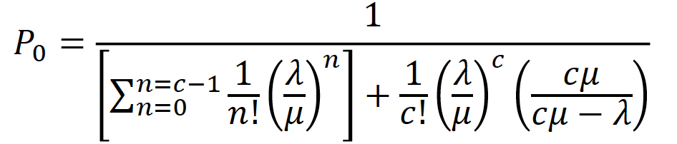
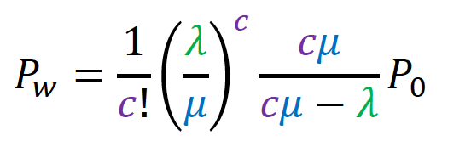
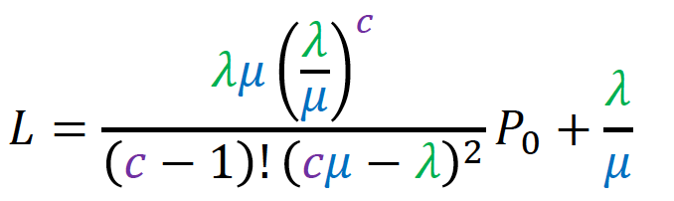
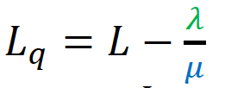
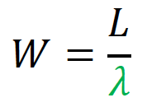
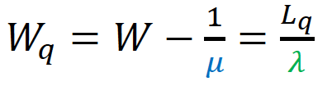
Number of staff and security Checkpoint
4-6 AM
Arrival rate = | 4927.00 | passengers per 2 hour
Service rate = | 620.68 | passengers per hour
c = | 8 | Check points
Po = | 0.000
Pw = | 0.975
Average number in the system (L) = | 132.65 | passengers
Average number in the queue (Lq) = | 124.716 | passengers
Average time in the system (W) = | 1.62 | minutes
Average time in the queue (Wq) = | 1.52 | minutes

Slide 12
Number of staff and security Checkpoint
Average time of a passenger in the system needs to be than 5 minutes.
Forecast Year 4
Time slot | Passengers | No. of Check points ( c ) | Average time in the system (W)
4-6 AM | 4927 | 8 | 1.62
6-8 AM | 5529 | 9 | 1.11
8-10 AM | 5783 | 10 | 0.21
10-noon | 3248 | 6 | 0.18
noon-2 PM | 4020 | 7 | 0.24
2-4 PM | 4249 | 7 | 0.68
4-6 PM | 3726 | 7 | 0.16
6-8 PM | 1724 | 3 | 0.47
8-10 PM | 528 | 1 | 0.65

Slide 13
Result and Analysis
Based on the passenger arrivals and the goal of keeping the average time in the system below 5 minutes, the number of security checkpoints has been adjusted accordingly.
The number of checkpoints varies throughout the day to match the passenger demand and maintain efficient flow through the security system.
Time slot | Planned No. of check points | No. of Check points ( c ) req.
4-6 AM | 6 | 8
6-8 AM | 6 | 9
8-10 AM | 6 | 10
10-noon | 6 | 6
noon-2 PM | 6 | 7
2-4 PM | 6 | 7
4-6 PM | 6 | 7
6-8 PM | 3 | 3
8-10 PM | 2 | 1

Slide 14
Thank you.

